Slide 2
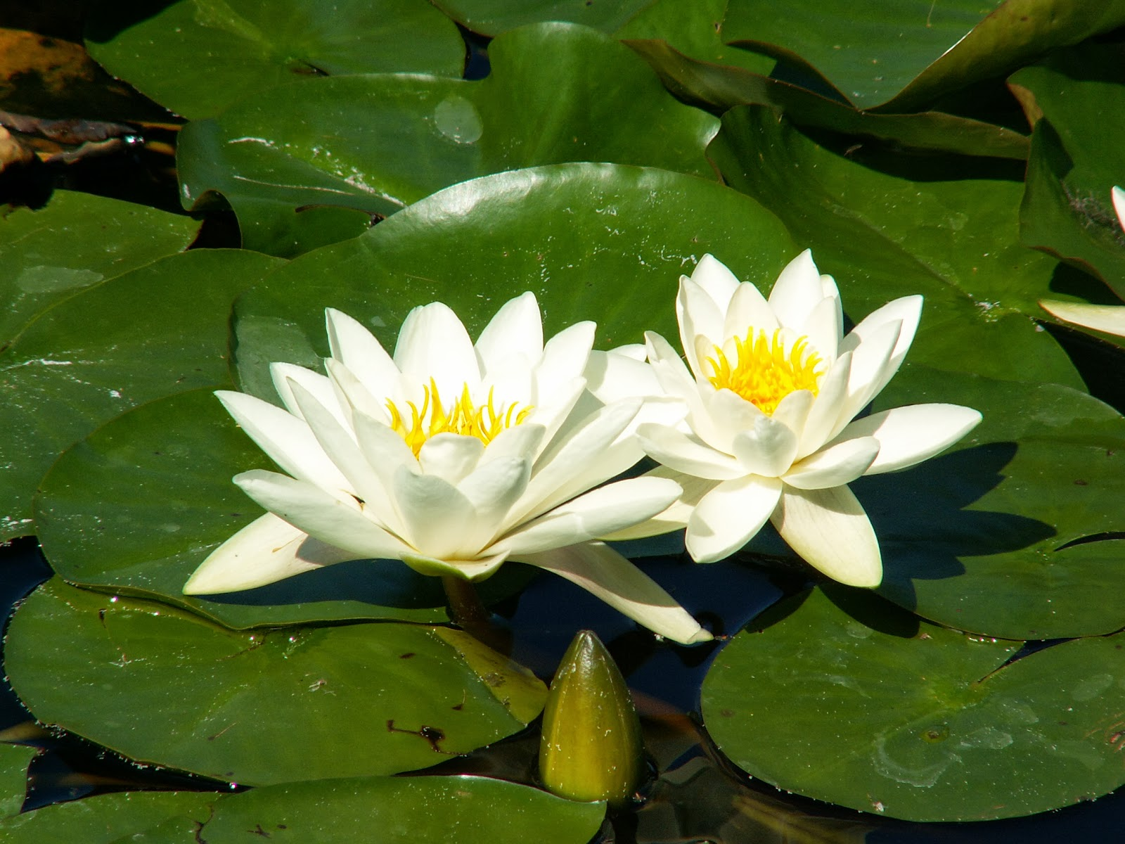
Welcome
My dear students

Slide 3
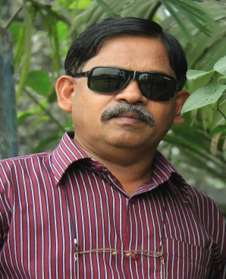
Myself
Andrius Animesh Baidya
Sr.asst.teacher (english )
Aditmari K B Girls’ High School & College
Aditmari , LALMONIRHAT
Mobile : 01728970460
andrius.animesh@gmail.com

Slide 4
Subject
English -1 paper
English for today
Class -9 , 10 .
Unite – 8
Lesson -1
Period – 2
Time - 50 minites
Date -……………….

Slide 5
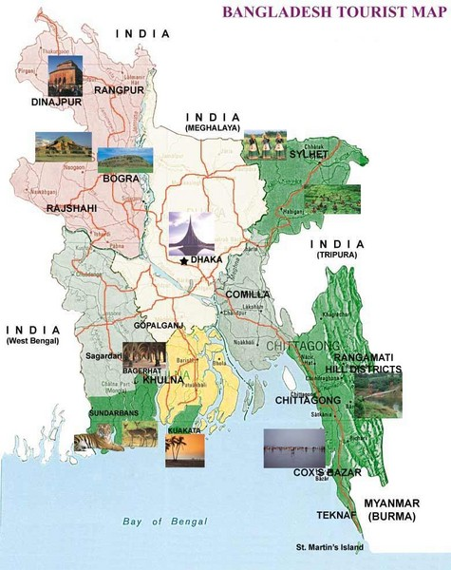

Slide 6
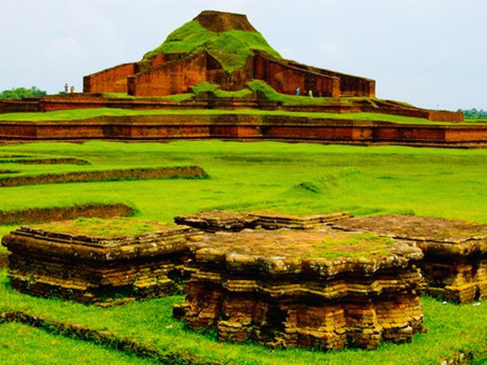
The Somapura Mahavihara

Slide 7
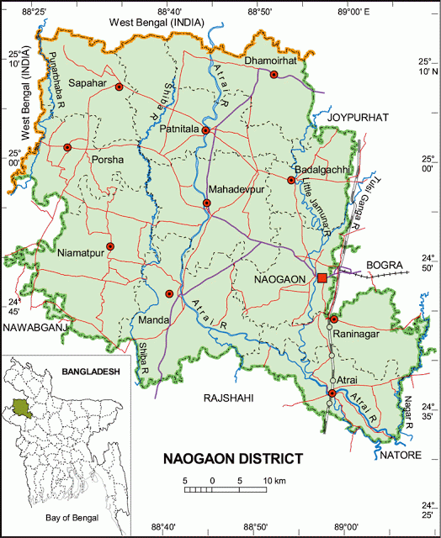

Slide 8
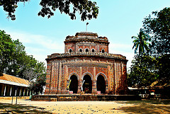
The Temple of Kantajeur

Slide 9
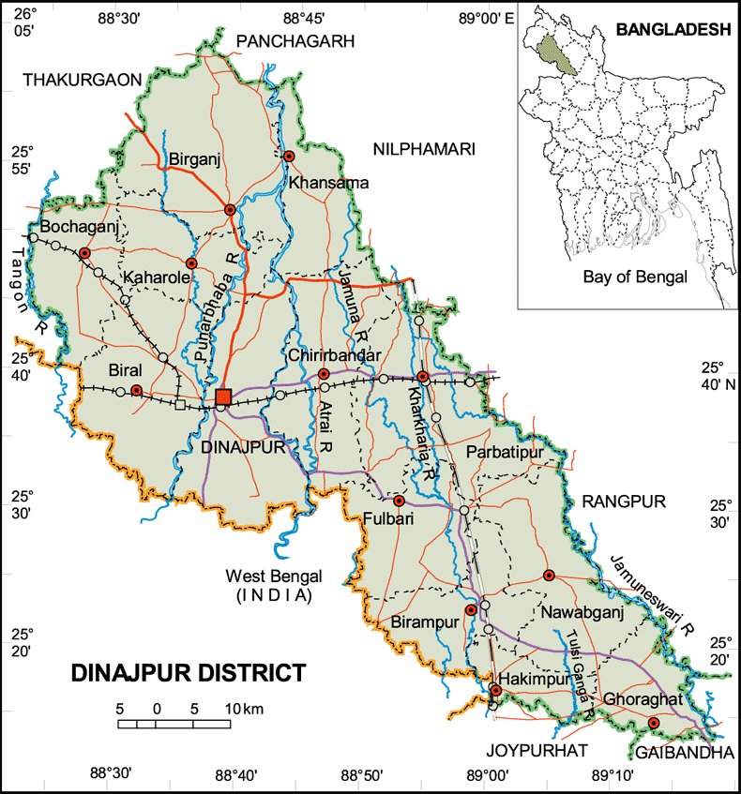

Slide 10
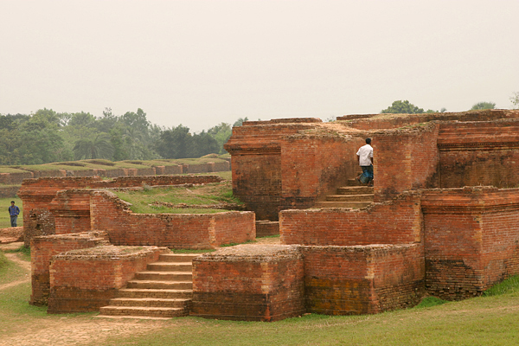
The Mainamoti Buddhabehar

Slide 11
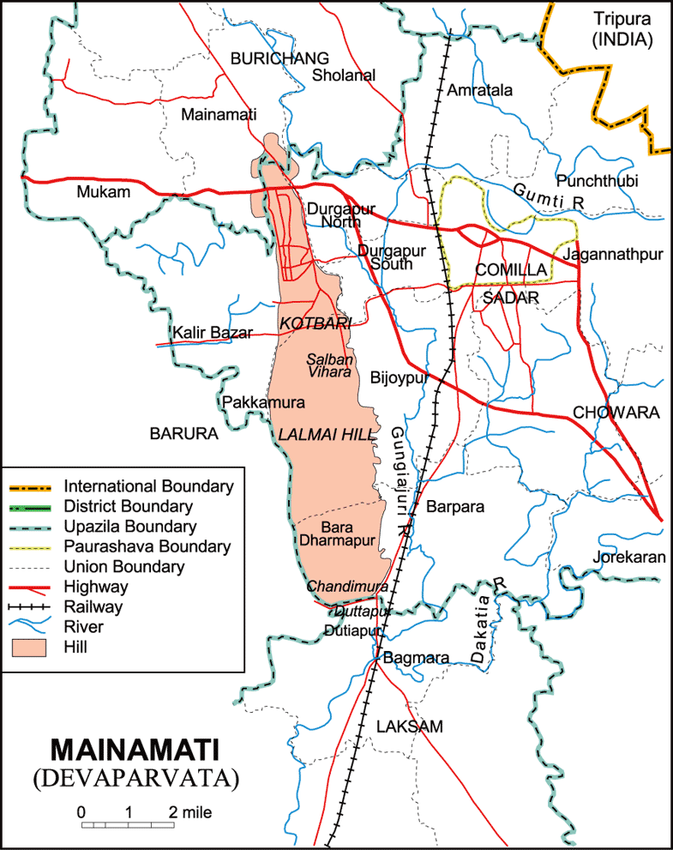

Slide 12
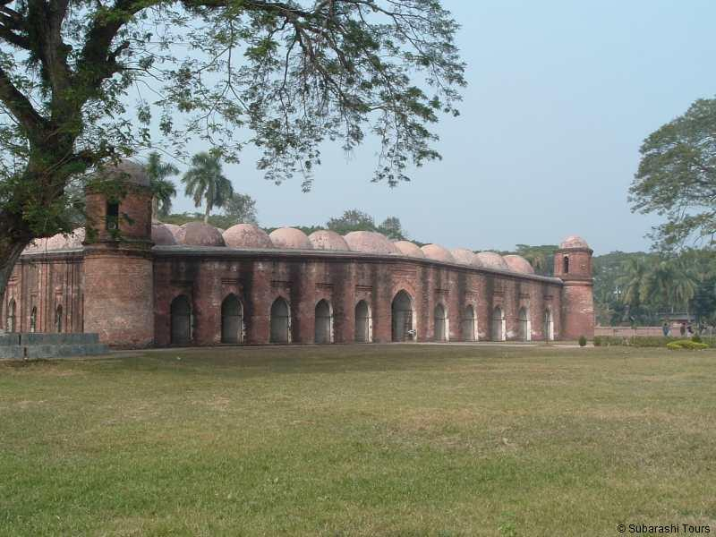
The Shat Gumbuj Mosque

Slide 13
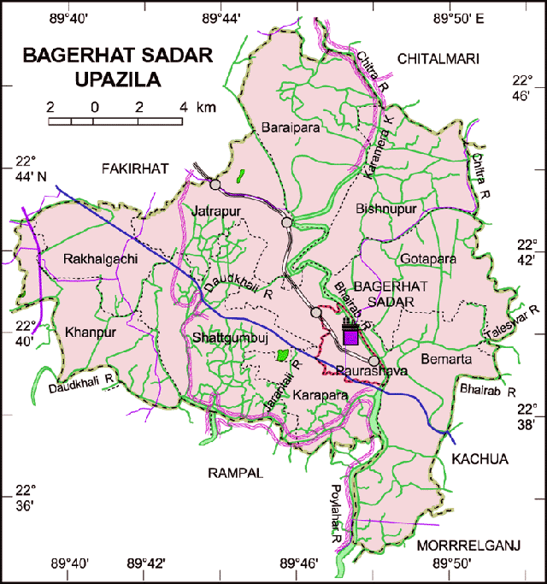

Slide 14
Our today’s lesson is
Shat Gambuj Mosque

Slide 15
Let us enjoy a video

Slide 16
Learning Outcomes
After learning this lesson you will be able to……………………
Listen for specific information
Describe a place

Slide 17
Model reading
Please open your book EFT, page 125

Slide 18
Word meaning
“Heritage”
What we inherit from the past, live with them and then pass on to our children or future generation
“World Heritage”
Places and sites that we got from the past and pass
on to the future generation of the entire world

Slide 19
Vocabulary
Architectural = architecture( noun ) + ral (suffix)
Combination = combine (verb) + tion (suffix)
Infrastructure = infra (prefix ) + structure ( noun )
Habitable = inhabite (verb) + able (suffix)
Slightly = slight (adjective) + ly (suffix)
Narrowing = narrow(adjective) + ing (suffix)

Slide 20
Silent reading

Slide 21
Individual Work
Answer the following questions…………
Q.1) What is the building?
Q.2)Do you have a building like this in
your town or village ?
Q.3)What do we call it ?

Slide 22
Pair Work
Write five sentences about an old mosque or a temple of your locality .

Slide 23
Group Work
Complete the chart
Shat Gambuj Mosque
Information
Founded by
Ulugh Khan Jahan Ali
When
In the 15th century
Number of domes
77 domes
Number of pillers
60 pillers
Mihrabs
11 mihrabs

Slide 24
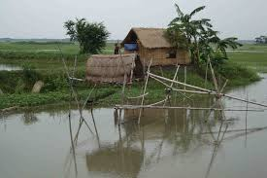
Home Work
Write a paragraph on
“Shat Gumbuj Mosque “
In about 150 words

Slide 25
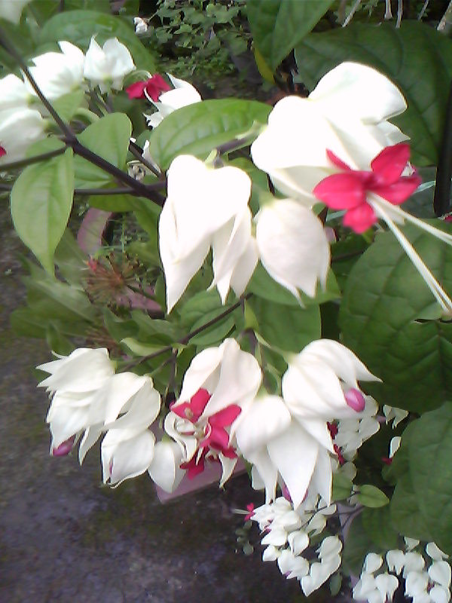
Good bye
Students

